Slide 1

What makes your Home a must-buy?
The most influential factors to consider when selling your home

Slide 2
Overview
Predictive Model built for this data set, home prices can be predicted with an 87% confidence rate.
Features included in the model were decided by how much they influence the price.

Slide 3
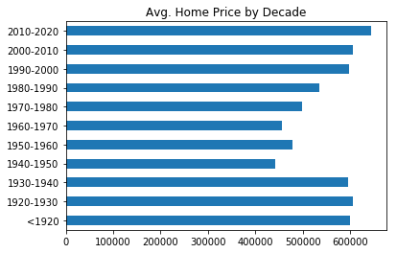
Influential Factor: Year Built
Homes built prior to 1940 and after 1970 seem to have a high value on average.

Slide 4
Influential Factor: View of the Waterfront

Slide 5
Influential Factor: Your Zip Code

Slide 6
Key Take-Aways and How to Interpret Model

